Slide 1
Student Grade Prediction
Guided By:
Dr. Amir H. Gandomi
Presented By:
Gaurav Sawant
Vipul Gajbhiye
Vikram Singh
Date: 11/28/2017

Slide 2
Introduction
Dataset : Student Alcohol Consumption
Source : https://www.kaggle.com/uciml/student-alcohol-consumption
Understand and clean the dataset
Identifying significant independent variables
Prediction using classification algorithms
Principal Component Analysis
Conclusion from our leanings
Tools: Microsoft Excel and R Studio

Slide 3
About the Dataset
Dataset : Student Alcohol Consumption
Source : https://www.kaggle.com/uciml/student-alcohol-consumption
Survey of students for Math course in a secondary school
396 Student Observations based on 33 attributes
Target variable G3 (final grade)
Goal: To predict student’s grade based on demographic and social factors

Slide 4
Data Preparation
No missing values in the dataset
Categorical variables transformed to factor variables
Dummy variables used to handle nominal variables
G3 variable was converted from continuous variable(numeric 0 to 20) to discrete variable (Pass/Fail Grade)
Dataset split into training and test set in 80:20 ratio

Slide 5
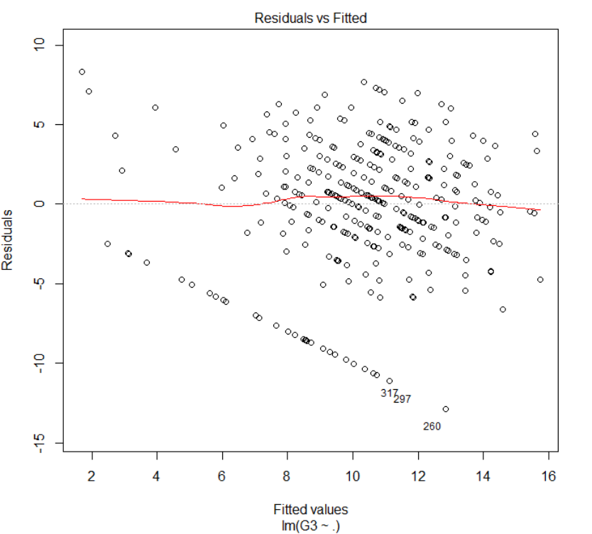
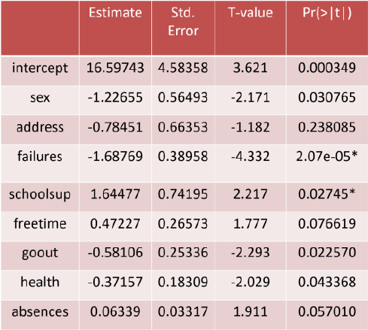
Multiple Regression
Fig.1: Residuals v/s fitted values for
final grade
Table1:Significant variables obtained after
performing multiple regression
We performed multiple regression and got 8 significant variables

Slide 6
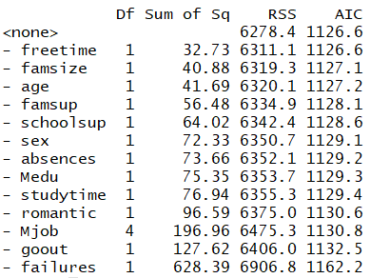
Stepwise Regression
Fig2: Significant variables obtained after performing
multiple regression

Slide 7
Logistic Regression
Logistic regression performed on 8 significant variables
Accuracy = 69.62%
Fig.3: Confusion Matrix
Fig.4: Plot for residuals v/s fitted values

Slide 8
Naïve Bayes
The accuracy percent achieved is 67.08%
The confusion matrix is as follows:
Fig.5: Confusion Matrix for Naïve Bayes

Slide 9
K-Nearest Neighbors
The accuracy percent achieved is 68.35%
The confusion matrix is as follows: K=5
Fig.6: Confusion Matrix for K-Nearest Neighbors

Slide 10
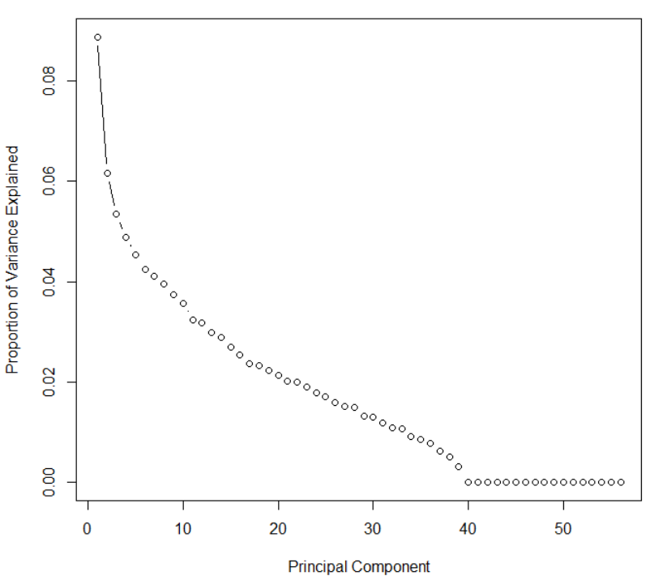
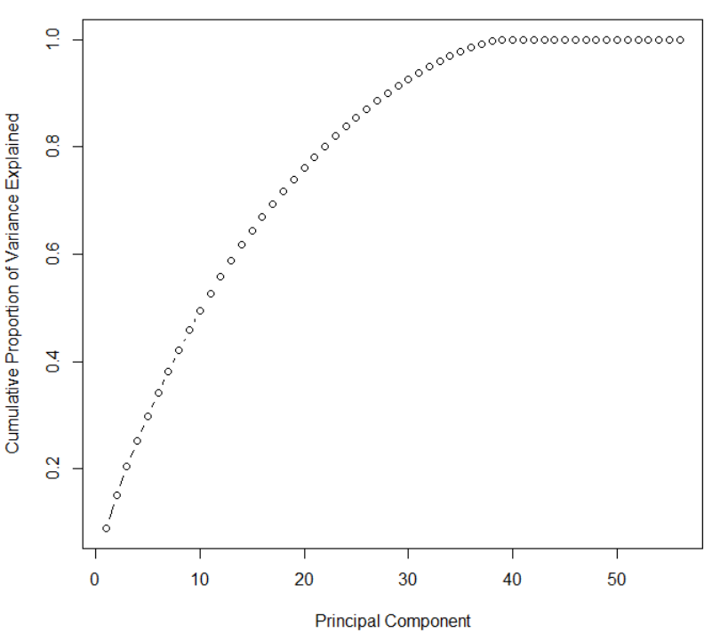
Principal Component Analysis
We had total of 57 variables after addition of dummy variables
Applied PCA and selected 15 PCs explaining 64.44% of variance
Fig.7: Proportion of variance vs PCs
Scree plot
Fig.8 : Cumulative variance vs PCs Scree plot

Slide 11
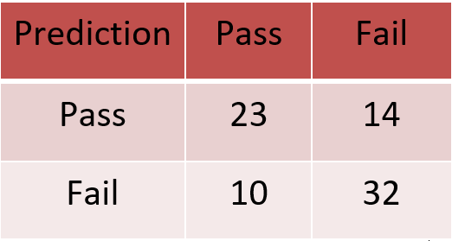
Logistic Regression with Principal Components
Performed Logistic Regression using the selected 15 PCs
Results not very different from normal Logistic Regression
Accuracy = 69.62%
Fig. 9: Confusion Matrix of Logistic Regression using
15 Principal Components

Slide 12
Conclusion
Variables like Dalc & Walc don’t play an important role in determining the student grade
Failures, sex, age, schoolsup, freetime, goout, health, absences are statistically significant
Tested classification algorithms returned similar accuracy (Range: 65%-70%)
Similar accuracy obtained on performing classification using Principal Components

